Slide 1

Recommendation Engine for
E-commerce Bookstore
Presented By
Team 3

Slide 2
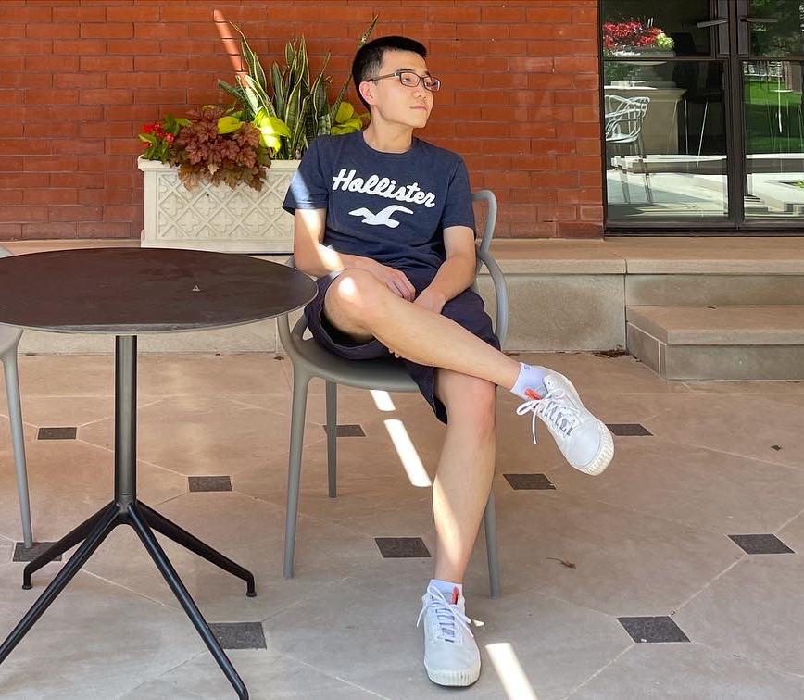




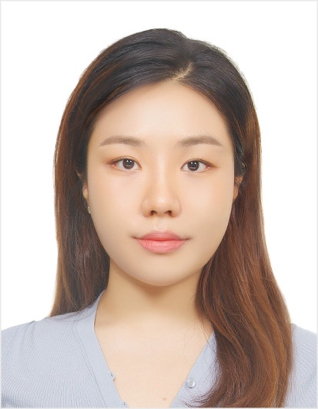
Meet Our Team
Hongxuan Zhao
Research Analyst
Wisdom Chen
Data Scientist
Rita Cui
Data Analyst
Jessy Hu
Business Analyst
Boya Zeng
Business Intelligence Analyst
Colleen Jung
Data Scientist

Slide 3

Executive Summary
01
02
03
Business Overview
Methodology & Solution
Results & Future Plan
Challenges E-commerce Bookstore face that require solutions or resolution.
Unsupervised Learning :
K-Means and PCA on RFM model to segment customer
Collaborative Filtering for Recommending product
Business Impact & Recommendations

Slide 4

01
BUSINESS OVERVIEW

Slide 5

Problem Statement
Current Situation
Operates on a one-size-fits-all recommendation model
primarily showcasing “most popular” items to all customers.
Objective
Develop a personalized "Recommendation Engine"
improve customer engagement, increase the average purchase size, and boost overall sales.

Slide 6
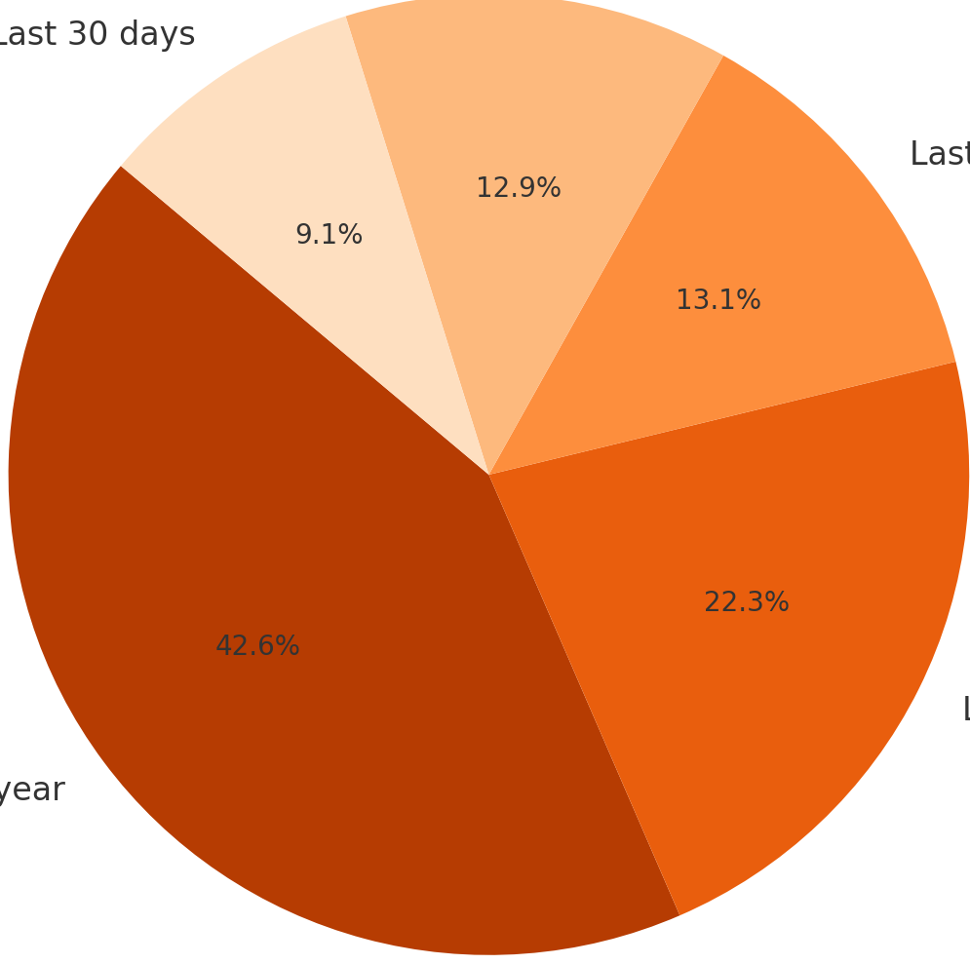
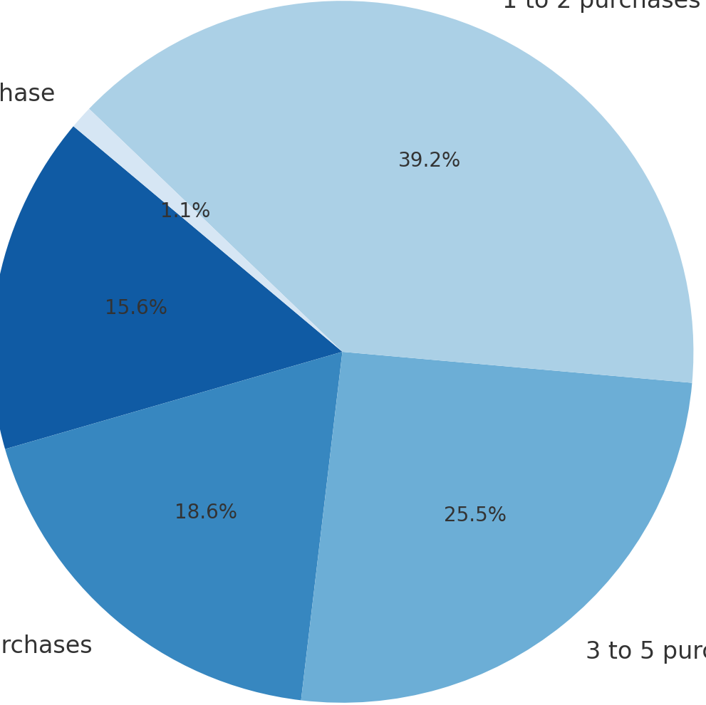
Key Insights on Customer Behavior
Low customer engagement & missed opportunities for sales
--Strategy Improvement Needed
Proportion of Customers By Recency
Proportion of Customers By Purchase Tier
Last 30 days
Single Purchase
Last 90 days
1 to 2 purchases
Last 6 months
More than 10 purchases
More than 1 year
3 to 5 purchases
Last 1 year
6 to 10 purchases

Slide 7

Solution & Analytical Goal：New Recommendation Engine
Step 1
Step 2
Step 3
Use unsupervised learning to segment customers based on their shopping behavior
Create personalized recommendation system based on their preference
Improve customer engagement, increase purchase size, and boost overall sales

Slide 8
02
Methodology & Solutions

Slide 9



Overview of Methodology Used for Clustering and Recommendation Engine
K-Means on RFM Model
Collaborative Filtering
R
Read by both users
Recency
Monetary
Similar User
Frequency
Time On File
Read by him，recommend to her

Slide 10
Methodology Comparison
Hierarchical Clustering
Density-Based Spatial Clustering
K-Means
Provides detailed dendrograms
But is computationally heavy for large datasets
Simple and Efficient
Effective with RFM Data
Easy to Interpret
Able to Identify outliers and clusters of arbitrary shapes
But less suitable for RFM data due to reliance on density parameters

Slide 11

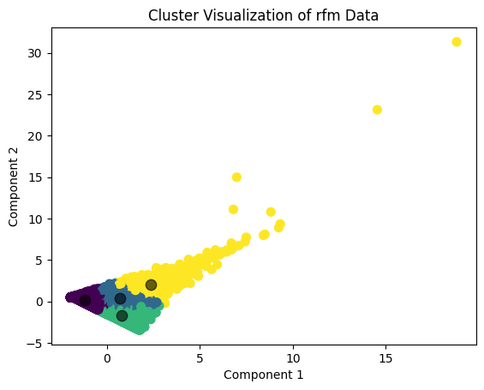
Market Trend
K-means:
Automatically partitions a dataset into distinct non-overlapping clusters
PCA:
Reduces the dimensionality of datasets, and increases interpretability

Slide 12
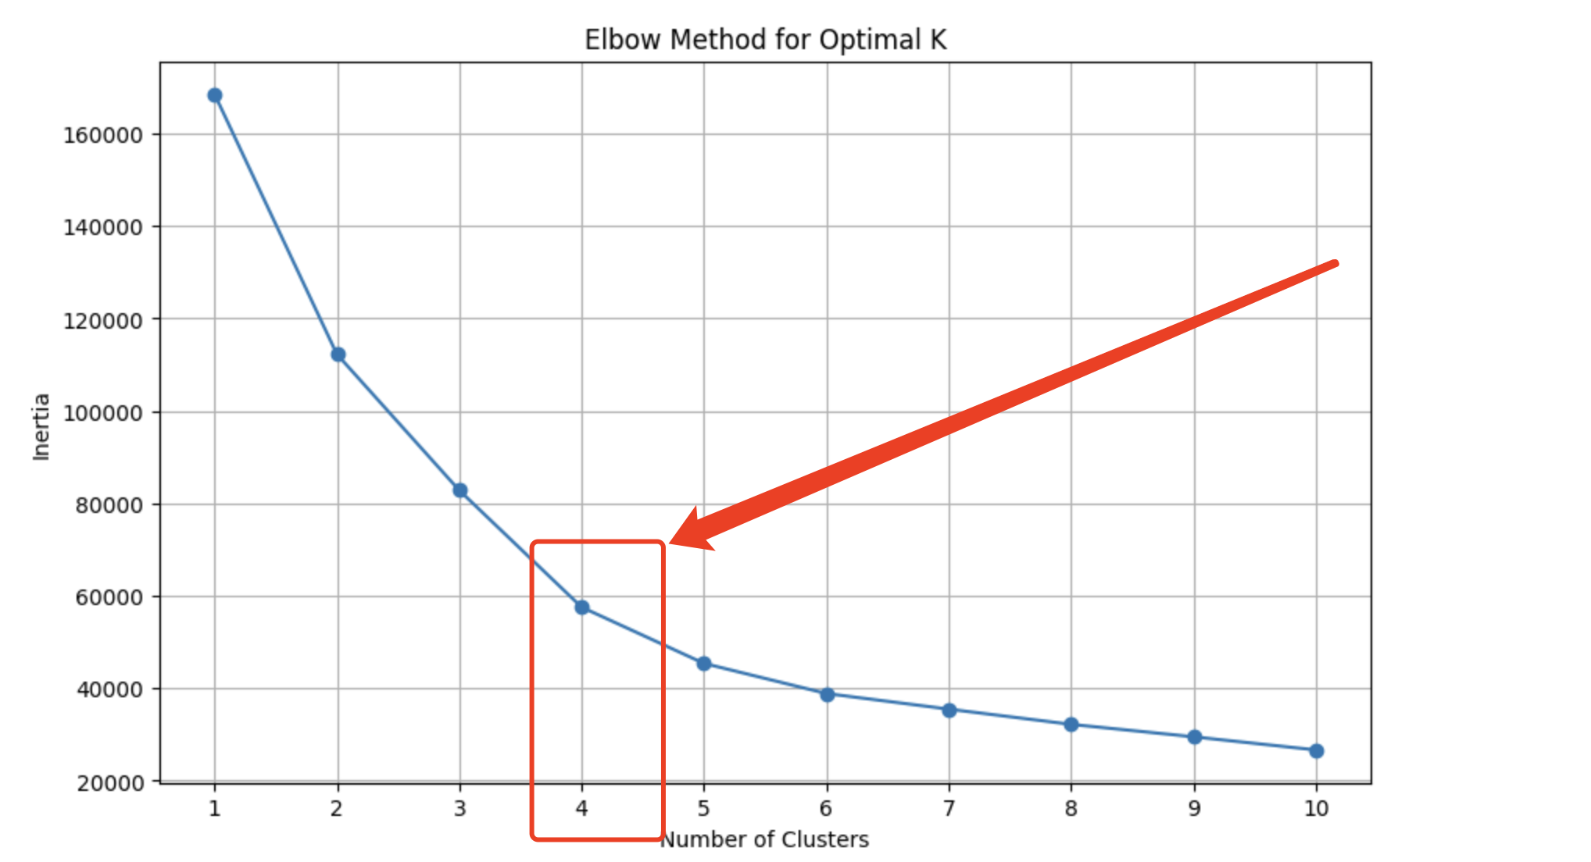
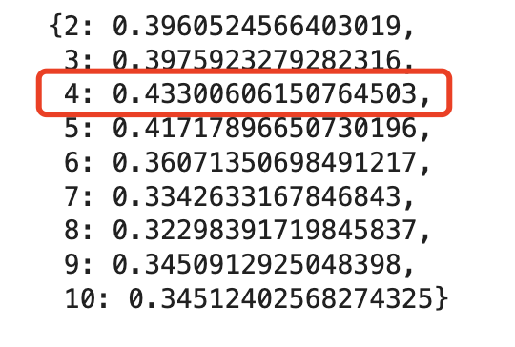
Model Evaluation: K-Means Clustering
We will choose cluster=4 to segment customers according to their RFM and Time on File

Slide 13

Customer Profile Based on Clustering
 | Customer Profile | Avg Recency | Avg Frequency | Avg Monetary | Avg Time on File
 | Inactive Customer | 1,413 | 3 | 115 | 1,859
 | General Customer | 319 | 9 | 312 | 1,906
 | New Customer | 254 | 2 | 80 | 481
 | Loyal Customer | 142 | 26 | 1,653 | 2,221

Slide 14



Sample Data Application
Customer ID | Recency | Frequency | Monetary | Time on File | Segment
45634 | 125 | 20 | 1,701 | 1,564 | Loyal Customer
54634 | 300 | 11 | 218 | 1,302 | General Customer
67474 | 1,345 | 2 | 89 | 1,765 | Inactive Customer
89905 | 9 | 45 | 3,677 | 1,800 | Loyal Customer
67462 | 251 | 3 | 100 | 376 | New Customer
Clustering of New Data
Every incoming customer/transaction will be assigned into one group

Slide 15

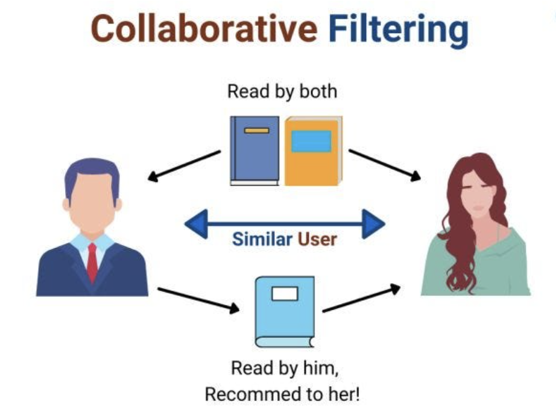
Recommendation Engine
––Collaborative filtering
Used by recommender systems to make predictions about the interests of a user by collecting preferences or taste information from many users
Higher similarity score indicates more recommended item

Slide 16
03
Results &
Preliminary Plan

Slide 17
Incentives Paired with Customer Segmentation
Customer Segment | Message | Strategy | Current Revenue
Inactive Customer (21%) | "We Miss You! Check Out What's New." | Offer a moderate discount (e.g., 15-20%) to re-engage them. | $0.8 M
General Customer (30%) | "Thanks for Your Loyalty! Here's Something Just for You." | Provide a loyalty reward discount or points (e.g., 10% off or double loyalty points). | $3.1 M
New Customer (43%) | "Welcome Aboard! Discover More with Special Offers." | Offer a welcome or first-time buyer discount (e.g., 20-25%) to encourage additional purchase. | $1.2 M
Loyal Customer (6%) | "Exclusive Selection for Our Valued Customer." | Minimal or no discount, as this segment is less price-sensitive. | $3.4 M

Slide 18
Business Impact
+15%
+10%
Based on the industry research, we can expect our recommendation engine to generate 10% - 30% revenue increase.
Boost the revenue to about $8.5 Million ~$10 Million
General Customer
Loyal Customer
Boost to ~10 Million
+30%
+25%
Inactive Customer
New Customer

Slide 19

Preliminary Plan
WEEK 2
WEEK 6
WEEK 1
WEEK 3-5
WEEK 7
Hypotheses & Modeling
Finalize recommendation
Research
Algorithm Development and Market Strategy Planning
Validate with Stakeholder

Slide 20
Future Step
STEP 1
Use frequency and monetary increase as key performance indicators
STEP 2
Design and conduct A/B testing; Compare a group of users that experience the recommendation engine against the group that does not
STEP 3
Collect user feedback
STEP 4
Analyze the increase in revenue; compare the additional revenue against the cost of developing and maintaining the recommendation engine.

Slide 21
Thank you

Slide 22
Appendix

Slide 23
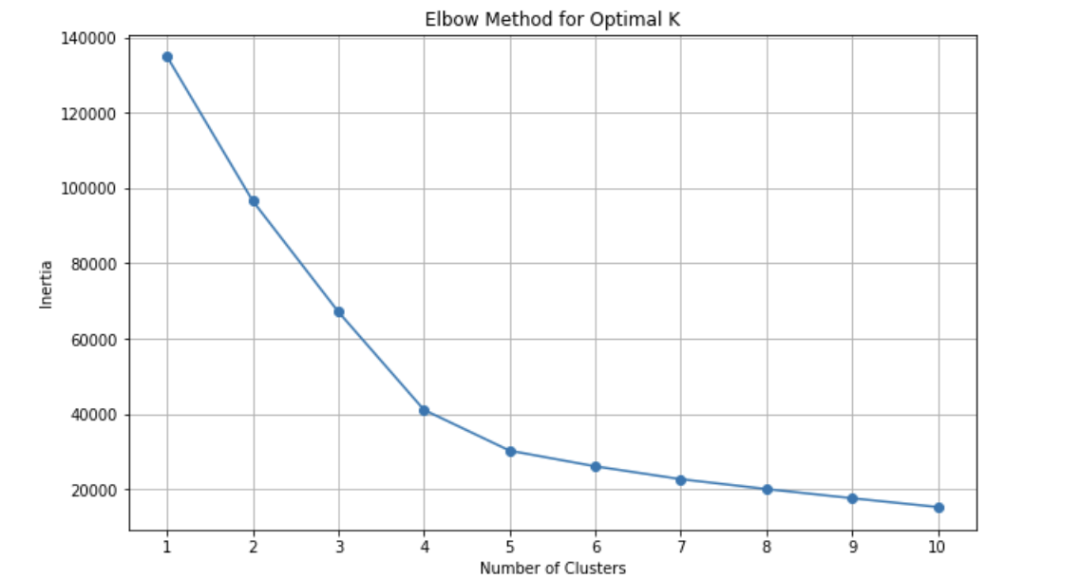
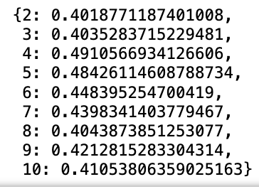
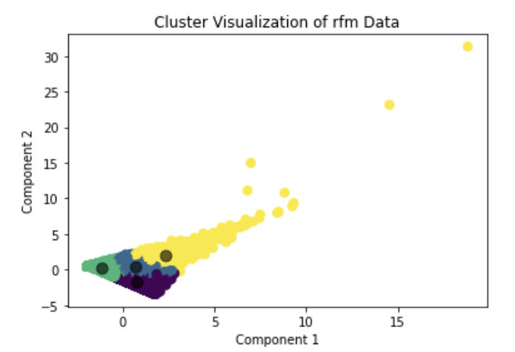
K-means Evaluation
Silhouette Scores
After we found the optimal K = 4, we use K =4 as our PCA components.

Slide 24
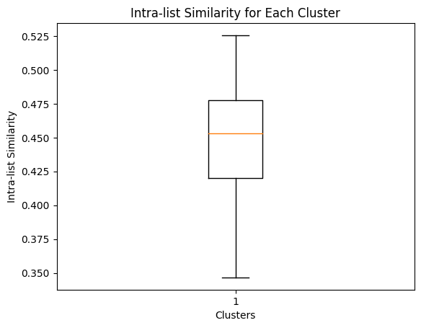
Recommendation Engine Evaluation
Average Intra-list Similarity: 0.44
Range of Intra-list Similarity: (0.35, 0.53)
Lower intra-list similarity score → higher diversity in the recommendations (Average score of 0.44 suggests moderate diversity)
Min value → 0.35 (Cluster most diverse recommendations)
Max value → 0.53 (Cluster with the least diverse recommendations)
The average Intra-list similarity is between the range of the Intra-list similarity, meaning that our model is stable. This make sense because according to the line (the median) is inside the box.

Slide 25
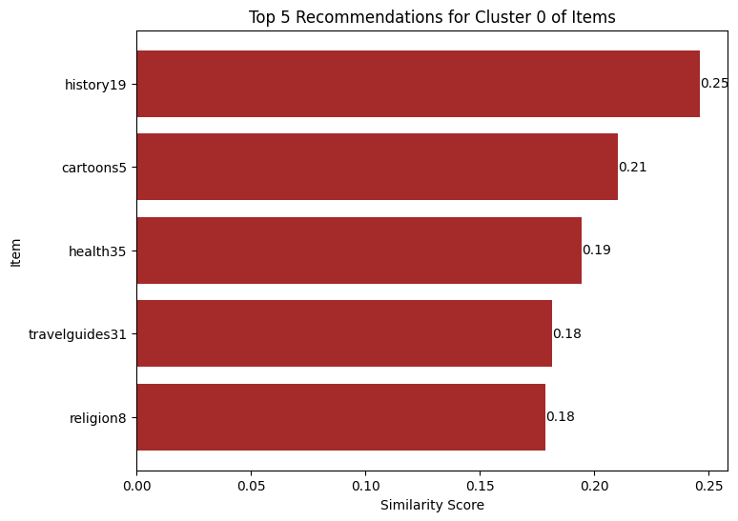
How Recommendation Engine Works
After add item-fiction1 in shopping cart, the Recommendation Engine would recommend:
History19 → 0.25
Cartoon5 → 0.21
Health35 → 0.19
travelguides31 → 0.18
Religion8 → 0.18

Slide 26
According to a report from Accenture, personalization increases the likelihood of a prospect making a purchase by 75%
According to a recent study by Barilliance, product recommendations were responsible for up to 31% of ecommerce revenues.
eg. Amazon attributes up to 35% of its revenue to its recommendation engine.
Based on the existing reports, we can expect our recommendation engine to generate 10% - 30% revenue increase.

Slide 27

Recommendation Engine Sample
Dashboard Demo Video Link

